Slide 1





Support Vector Machines

Slide 2
Index
Introduction
Linear SVM
Non-Linear SVM
Hyperplane and support vectors
Working of SVM
Linear
Non-Linear
Math in SVM
Kernels in SVM
Polynomial
Radial

Slide 3
What?
Machine Learning
Supervised
Classification
Regression
Unsupervised
Clustering
One of the most popular Supervised Learning algorithms, which is used for Classification as well as Regression problems.(Primarily Classification)
Notes:
The goal of the SVM algorithm is to create the best line or decision boundary that can segregate n-dimensional space into classes so that we can easily put the new data point in the correct category in the future. This best decision boundary is called a hyperplane.

Slide 4
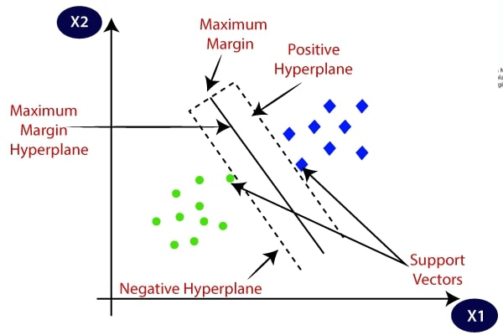
Choose extreme vectors for hyperplane
Extreme cases – Support vectors
Notes:
Consider the below diagram in which there are two different categories that are classified using a decision boundary or hyperplane:

Slide 5
Linear SVM
Used for Linear Separable data → Can be classified by straight line
This classifier is called Linear SVM classifier

Slide 6
Non-Linear SVM
Used for non-linearly Separable data → Cannot be classified by straight line
This classifier is called Non-linear SVM classifier

Slide 7
Hyperplane
Multiple lines/boundaries can separate classes in n-dimensional space, we need to decide the best one
Best boundary – Hyperplane of SVM
Dimension of hyperplane – Based on features of dataset
2 features – 1D Straight line hyperplane
3 features – 2D plane Hyperplane
Create hyperplane with Maximum Margin
Notes:
There can be multiple lines/decision boundaries to segregate the classes in n-dimensional space, but we need to find out the best decision boundary that helps to classify the data points. This best boundary is known as the hyperplane of SVM.
The dimensions of the hyperplane depend on the features present in the dataset, which means if there are 2 features , then hyperplane will be a straight line. And if there are 3 features, then hyperplane will be a 2-dimension plane.
We always create a hyperplane that has a maximum margin, which means the maximum distance between the data points.

Slide 8
Support Vectors
Vectors(data points) that are closest to hyperplane
They affect position of hyperplane
These support hyperplane → Support Vector

Slide 9

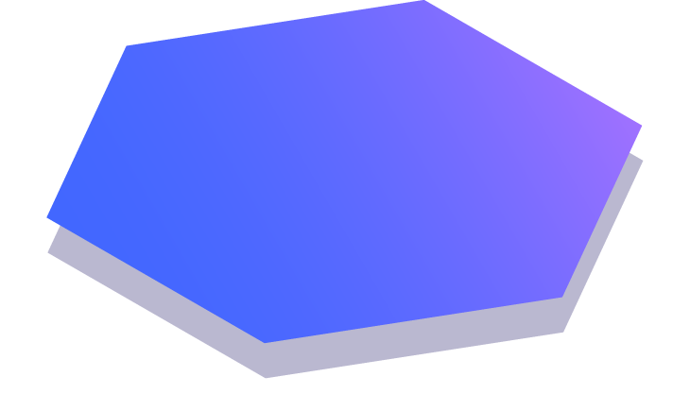
How ?
Working of Linear and Non Linear SVM

Slide 10
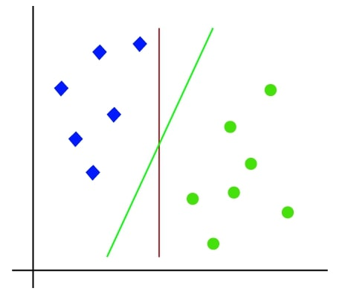
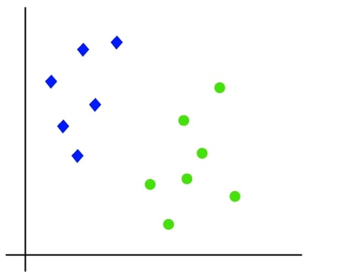
Linear SVM (Working)
1
Dataset with two tags(green and blue).
Two features x1 and x2
Aim: Classifier to classify the pair(x1,x2)
2
2D space → Classified by a straight line
But multiple lines can separate these.

Slide 11
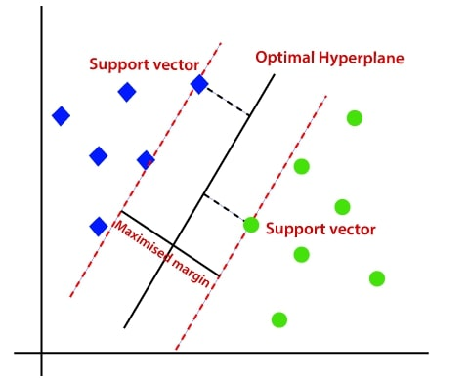
Linear SVM (working)
3
SVM algorithm finds best decision boundary.
Best boundary – Hyperplane
Closest points – Support vectors
The distance between the vectors and the hyperplane - Margin.
Aim: Maximize the margin
Notes:
There can be multiple lines/decision boundaries to segregate the classes in n-dimensional space, but we need to find out the best decision boundary that helps to classify the data points. This best boundary is known as the hyperplane of SVM.
The dimensions of the hyperplane depend on the features present in the dataset, which means if there are 2 features , then hyperplane will be a straight line. And if there are 3 features, then hyperplane will be a 2-dimension plane.
We always create a hyperplane that has a maximum margin, which means the maximum distance between the data points.

Slide 12
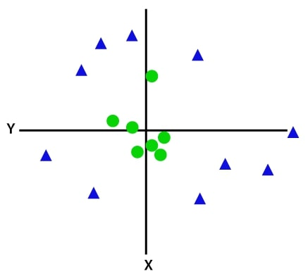
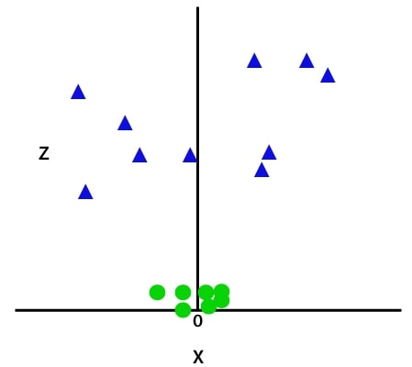
Non - Linear SVM (Working)
1
Straight lines cannot be used for non-linear data
2
To separate points, we add one more dimension.
Non-linear data - we add 3rd dimension.
Z = x² +y²

Slide 13
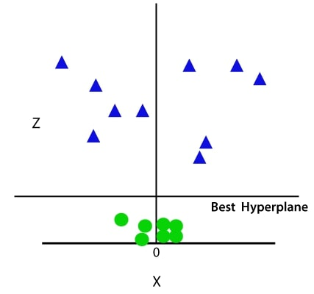
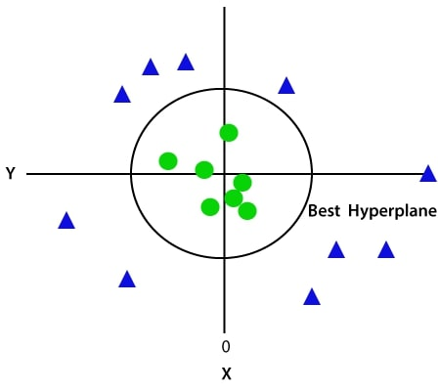
Non - Linear SVM (Working)
4
Now we have 3D space
Looks akin to plane parallel to x-axis
Convert to 2D with z = 1:
3
SVM divides dataset as shown in the graph below
We get a circumference of radius 1 in case of non-linear data.

Slide 14
The Math !
How SVM works on a mathematical level

Slide 15
The use of math
Finding the support vectors with maximum distance
For separating the points efficiently
Also finding the margin separation

Slide 16


Example
(4,4)
Here m = -1 and b = 0.
We get y = $ω^{T}x+0$
$\left[\begin{matrix}−1 \\ 0\end{matrix}\right]\left[−4 0\right]$ = 4 → Positive
$\left[\begin{matrix}−1 \\ 0\end{matrix}\right]\left[4 4\right]$ = -4 → Negative
(-4,0)
$$ω^{T}x+b=0$$
Slope = -1

Slide 17

(4,4)
(-4,0)
$$ω^{T}x+b=0$$
Slope = -1

Slide 18
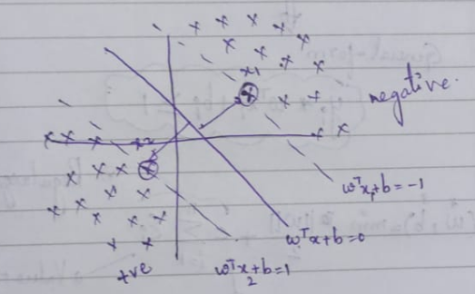

General Equation of SVM in math
Maximum distance between points
x1 and x2 are the vector points
Above x1 → -ve Below x2 → +ve
$ω^{T}x_{1}+b$ = -1 $ω^{T}x_{2}+b$ = 1

Slide 19


$ω^{T}x_{1}+b$ = -1 $ω^{T}x_{2}+b$ = 1
Solved equation: $ω^{T}\left(x_{2}−x_{1}\right)=2$
We need to remove the $ω^{T}.$
$\frac{ω^{T}}{\left\|ω\right\|}\left(x_{2}−x_{1}\right)$ = $\frac{2}{\left\|ω\right\|}$
Should be optimized (Maximized)

Slide 20

Optimization function
$\left(ω^{∗},b^{∗}\right)=max\frac{2}{\left\|ω\right\|}$
$y_{i}\left(ω^{T}x_{i}+b_{i}\right)≥1$
$\left(ω^{∗},b^{∗}\right)=min\frac{\left\|ω\right\|}{2}+c\sum_{1}^{n}{ε_{i}}$

Slide 21
SVM Kernels
Types and functions

Slide 22
How Kernels Work
Start with data in lower dimension
Move the data to higher dimension
Find classifier to separate the higher dimension data

Slide 23
Example:
Dosage²
Dosage of Medicines

Slide 24
Polynomial Kernel
Can be of varying degrees (parameter d)
d = 1 → Relations in 1D
d = 2 → Relations in 2D (like dosage² )
The parameter d - found using cross validation
The relations - Used to find Classifier

Slide 25

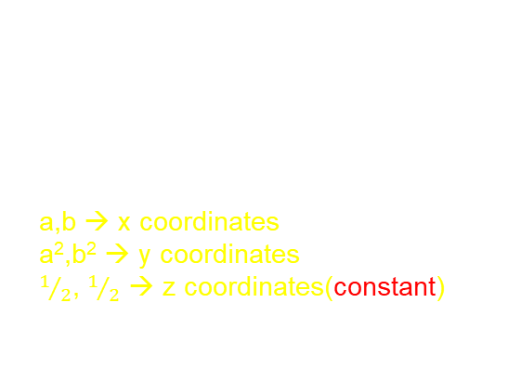
Example:
$${\left(a×b+r\right)}^{d}$$
a,b → Two different observations
r → Coefficient of polynomial
d → Degree of polynomial
Set r = ½ and d = 2:
${\left(a×b+1/2\right)}^{2}$ = $ab+a^{2}b^{2}+1/4$
=$\left(a,a^{2},1/2\right)⋅\left(b,b^{2},1/2\right)$
a,b → x coordinates
a²,b² → y coordinates
$1/2$, $1/2$ → z coordinates(constant)

Slide 26
Radial Kernel
Parameters
How Radial Kernel calculates high – dimensional relationships
How Radial Kernel works in infinite dimension

Slide 27
Training dataset – Drug Dosages
Red dotes - Patients that were not cured
Green dotes – Patients that were cured
It only works if the
dosage is just right
Drug doesn’t work if
the dosage is too large
Drug doesn’t work if
the dosage is too small

Slide 28
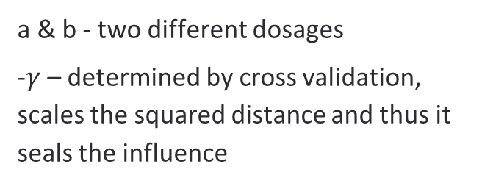

To deal with overlapping data is to use a Support Vector Machine with Radial Kernel
$e^{−γ(a−b)^{2} }$
a & b - two different dosages
-$γ$ – determined by cross validation, scales the squared distance and thus it seals the influence

Slide 29

Dosages which are near
If $γ$ = 1
$$e^{−(a−b)^{2}}$$
Take a & b which are relatively close to each other
$$e^{−(2.5−4)^{2}}$$
$$e^{−(−1.5)^{2}}$$
$$e^{−(2.25)}$$
$$= 0.11$$
(high dimensional relationship)
near

Slide 30

If $γ$ = 2
$$e^{−2(a−b)^{2}}$$
Take a & b which are relatively close to each other
$$e^{−2(2.5−4)^{2}}$$
$$e^{−2(−1.5)^{2}}$$
$$e^{−2(2.25)}$$
$$= 0.01$$
$γ$ = 1 > $γ$ = 2
$γ$ = 1 high dimensional relationship
near

Slide 31

Dosages which are far away
If $γ$ = 1
$$e^{−(a−b)^{2}}$$
Take a & b which are relatively far away from to each other
$$e^{−(2.5−16)^{2}}$$
$$e^{−(−13.5)^{2}}$$
$$e^{−(182.25)}$$
$$=Number very close to zero$$
(high dimensional relationship)
Far away

Slide 32




Farther the observation are from each other the less influence they have on each other
$e^{−γ(a−b)^{2} }$
(high dimensional relationship)
$$\left(a∗b+r\right)^d$$
Use Polynomial Kernel to give us intuition into how the Radial Kernel works in Infinite - Dimension
$e^{−γ(a−b)^{2} }$
When r = 0
${\left(a∗b+r\right)}^{d}$ = ${\left(a∗b\right)}^{d}$
= $a^{d}$. $b^{d}$
= ($a^{d}$). ($b^{d}$)

Slide 33
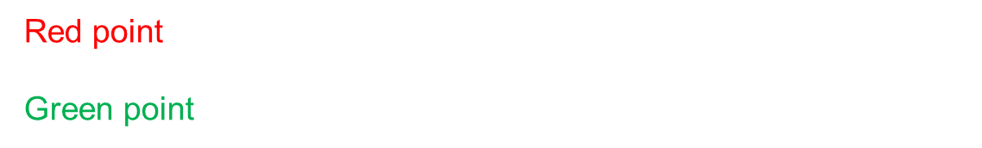

When r = 2
$a^{2}$. $b^{2}=$($a^{2}$). ($b^{2}$)
a = 2.5
b = 4
${2.5}^{2}$. $4^{2}=$(${2.5}^{2}$). ($4^{2}$)
Red point - new x-axis coordinate for this point is ${2.5}^{2}$ = 6.25
Green point – new x-axis coordinate for this point is $4^{2}$ = 16

Slide 34

When r = 0 & d = 2 all the Polynomial Kernel does is shift the data down the original axis
When r = 0 & d = 3
${2.5}^{3}$. $4^{3}=$(${2.5}^{3}$). ($4^{3}$)
When r = 0 & d = 1
Remains the same in 1- D

Slide 35
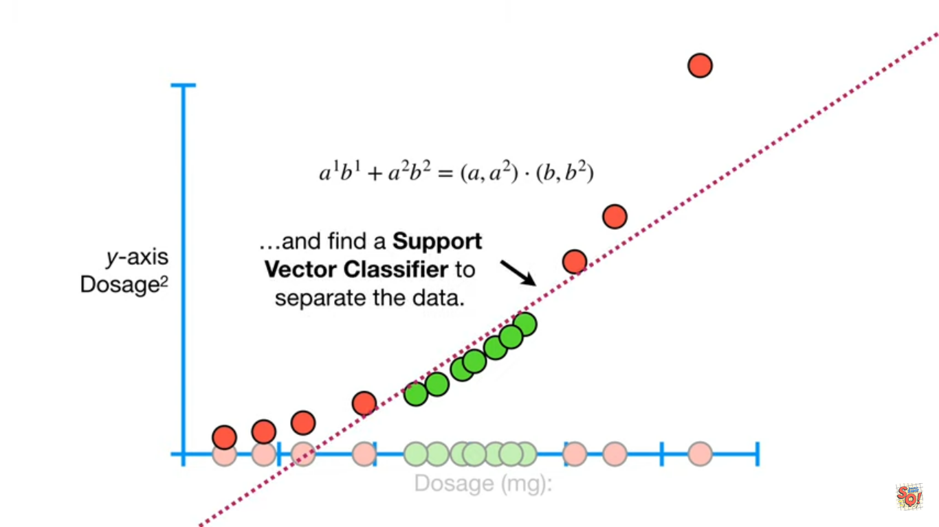

If we take a Polynomial Kernel with r = 0 & d = 1 and add another Polynomial Kernel with r = 0 & d = 2
$a^{1}$. $b^{1}+a^{2}\text{. }b^{2}=$(${a,a}^{2}$). (${b,b}^{2}$)

Slide 36
When we add r = 0 & d = 3
$a^{1}$. $b^{1}+a^{2}\text{. }b^{2}+a^{3}\text{. }b^{3}=$(${a,a}^{2},a^{3}$). (${b,b}^{2},b^{3}$)
When Polynomial Kernel with r = 0 & decreasing d until d = infinity
$a^{1}$. $b^{1}+a^{2}\text{. }b^{2}+a^{3}\text{. }b^{3}+a^{∞}\text{.}b^{∞}=$(${a,a}^{2},a^{3},…,a^{∞}$). (${b,b}^{2},b^{3},…,b^{∞}$)

Slide 37
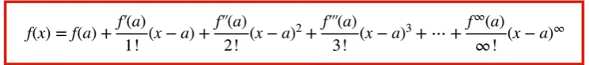

MATHS PART
$e^{−γ(a−b)^{2}}=e^{−γ(a^{2}−b^{2}−2ab) }$
$=e^{−γ(a^{2}−b^{2}) }e^{γ 2ab }$
${=e}^{−1/2\left(a^{2}−b^{2}\right) }e^{ab }$
Lets set it into $γ=1/2$
Taylor series

Slide 38
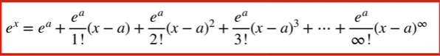
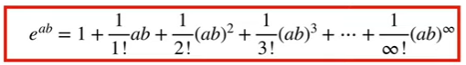



a?
a can be any value as long as f (a) exist
$$e^{0}=1 ,$$
$$e^{0} exist$$
We will set a = 0
$$e^{x}=1$$
$e^{x}=e^{0}+\frac{e^{0}}{1!}\left(x−0\right)+\frac{e^{0}}{2!}{\left(x−0\right)}^{2}+\frac{e^{0}}{3!}{\left(x−0\right)}^{3}+…+\frac{e^{0}}{∞!}{\left(x−0\right)}^{∞}$
$e^{x}=1+\frac{1}{1!}x+\frac{1}{2!}x^{2}+\frac{1}{3!}x^{3}+…+\frac{1}{∞!}x^{∞}$

Slide 39
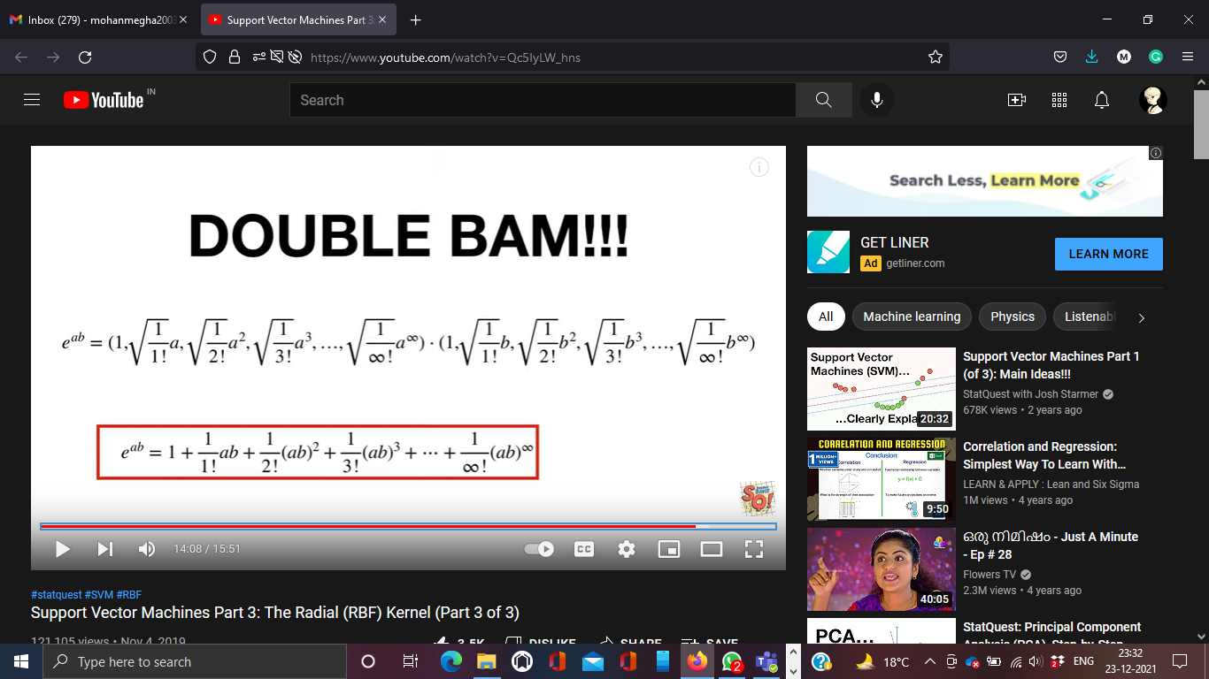
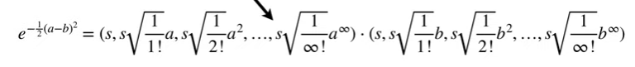



Dot product for $e^{ab}$ Taylor series Expression is
Back to
$$e^{−γ(a−b)^{2}}=e^{−γ(a^{2}−b^{2}−2ab) }{=e}^{−1/2\left(a^{2}−b^{2}\right) }e^{ab }$$
$$e^{−1/2\left(a^{2}−b^{2}\right) }$$
$${=e}^{−1/2\left(a^{2}+b^{2}\right) }$$
s${=e}^{−1/2\left(a^{2}+b^{2}\right) }$

Slide 40
Thank you

